Slide 1

Cyber Security Workshop
Presented By :
Muhammad waseem
www.linkedin.com/in/muhammadwaseem00

Slide 2
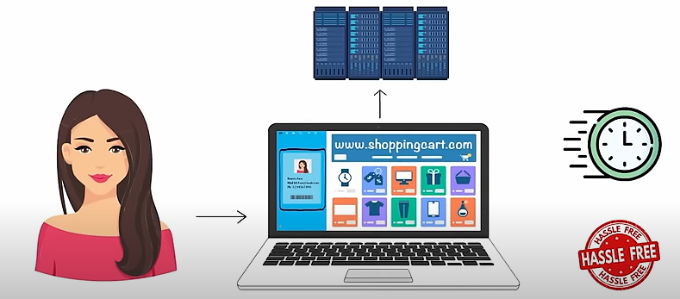
Anna

Slide 3

Facebook remove account

Slide 4

Cyber Security
It is the practice of protecting computer systems, networks, and digital information from theft, damage, unauthorized access, or any form of cyber threats

Slide 5

Cyber Security expert demand in Trade
~3.50 trillion to ~10.5 trillion

Slide 6
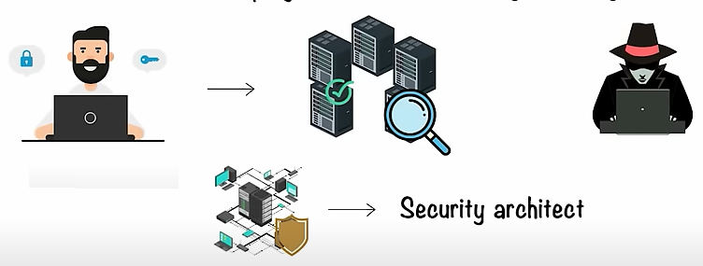

There are Multiple Job Role in Cyber Security
Ethical Hacker
CISO(Chief Information Security of Officer)

Slide 7
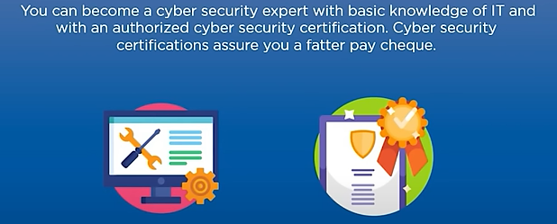
Basic Requirements

Slide 8
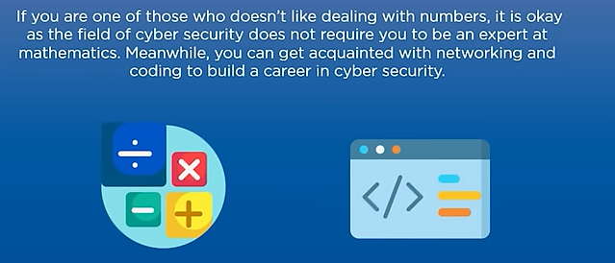
Math is not a Necessity

Slide 9
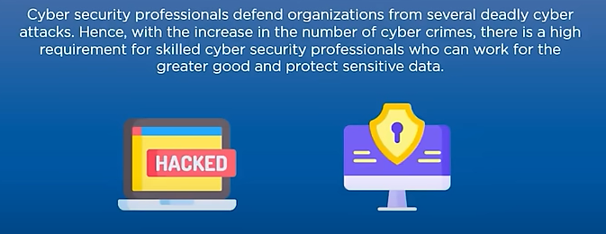
A Profession that helps achieve the Greater Good

Slide 10
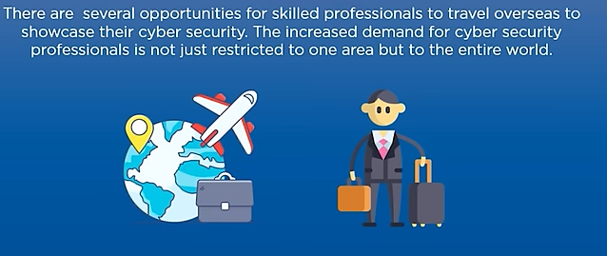
You Get to Travel the World

Slide 11
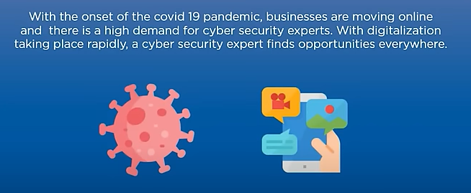
Cyber Security is an Evergreen Industry

Slide 12
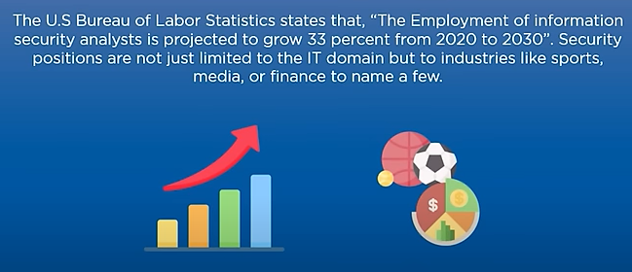
Plenty of Jobs Opportunities

Slide 13
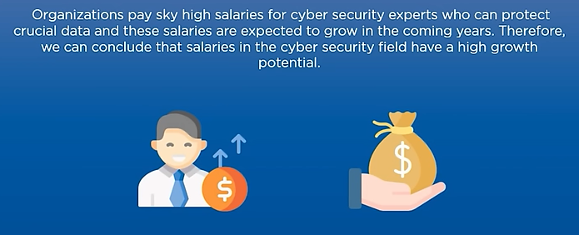
Good Salary Package

Slide 14
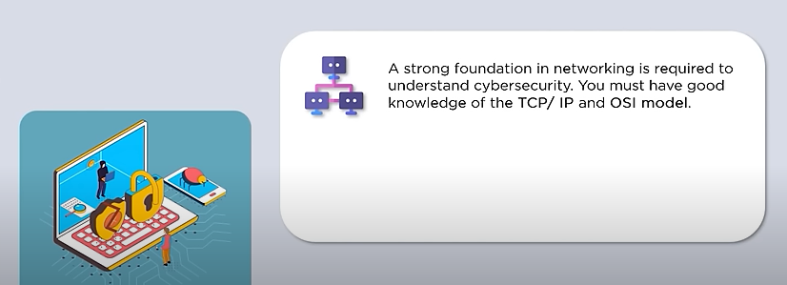
Networking and System Security

Slide 15
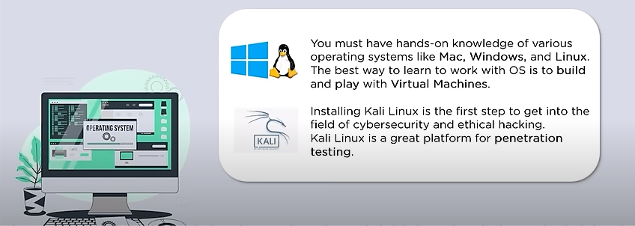
Operating System and Virtual Machine

Slide 16
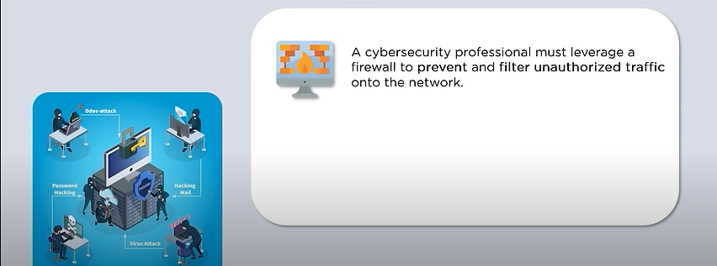
Network Security Control

Slide 17
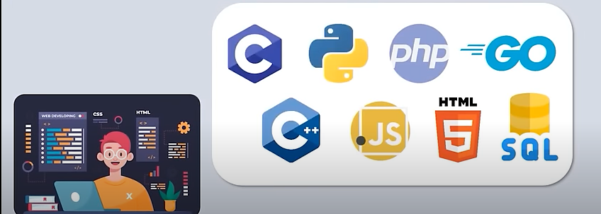
Coding Languages

Slide 18
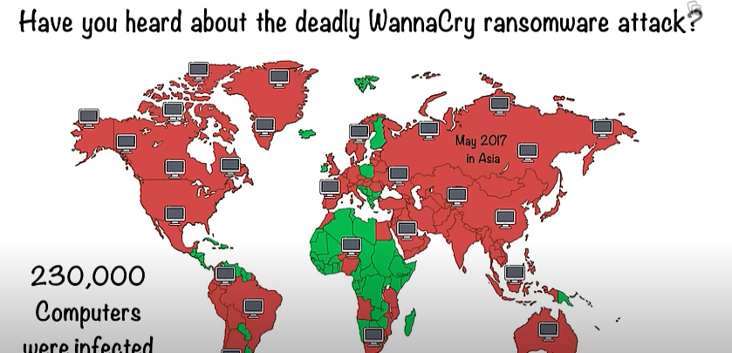

Slide 19
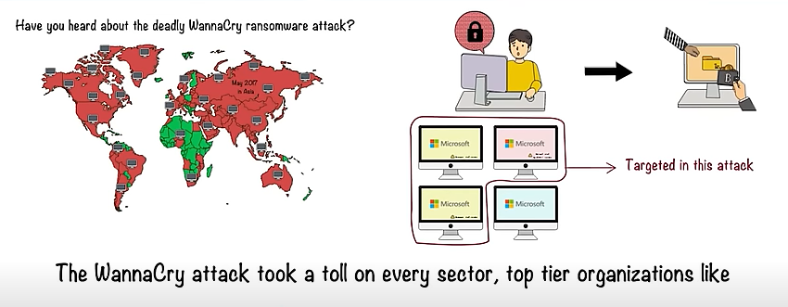


Slide 20
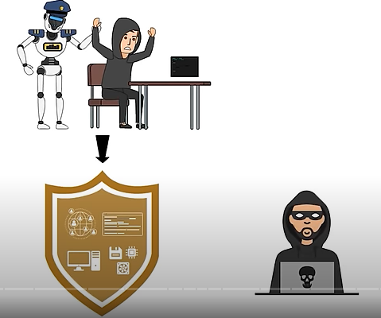
To Prevent such Attacks

Slide 21
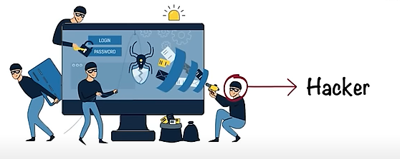
Hacking

Slide 22
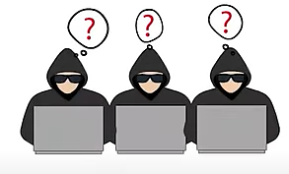
It is a misconception that hacking is always wrong

Slide 23
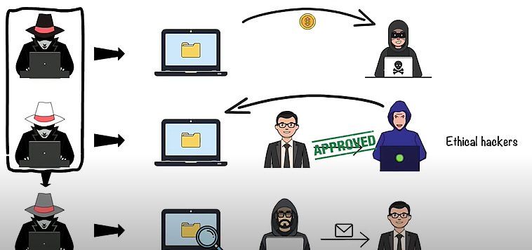
Let’s have look of different types of hackers
They do that without owner’s approval

Slide 24
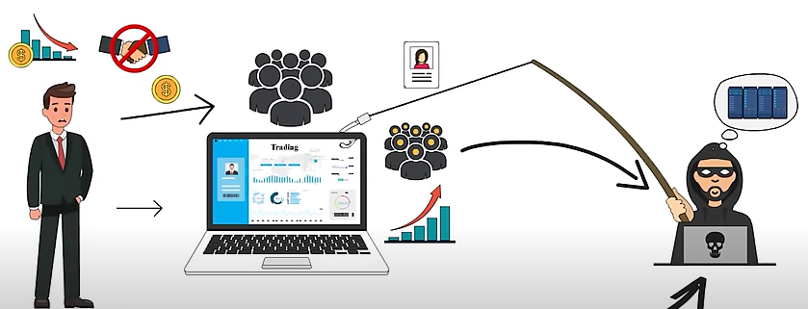

Ethical Hacking

Slide 25
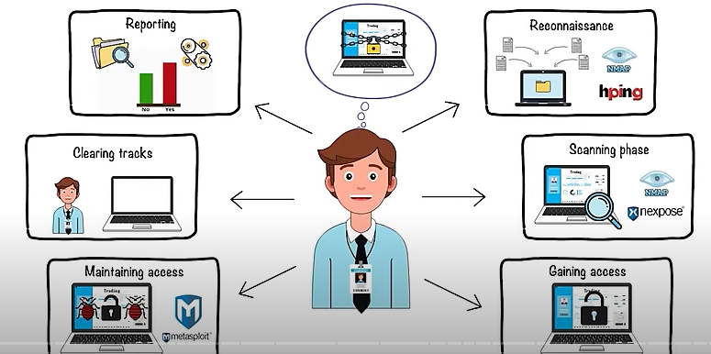
Ethical Hacking is Distributed in six Phases

Slide 26

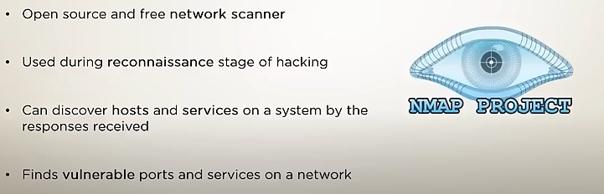
Tools for Ethical Hacking

Slide 27

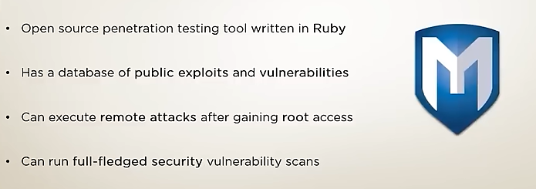
Tools for Ethical Hacking

Slide 28

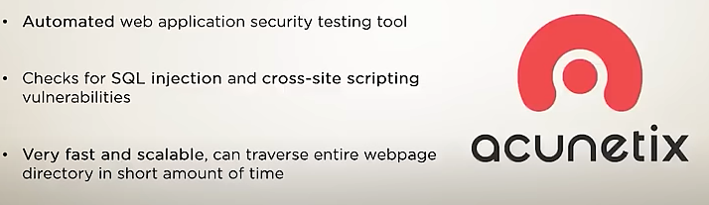
Tools for Ethical Hacking

Slide 29

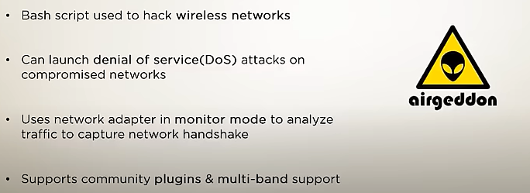
Tools for Ethical Hacking

Slide 30

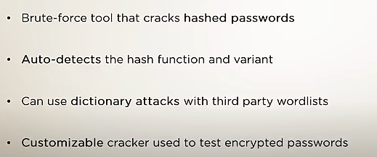
Tools for Ethical Hacking

Slide 31
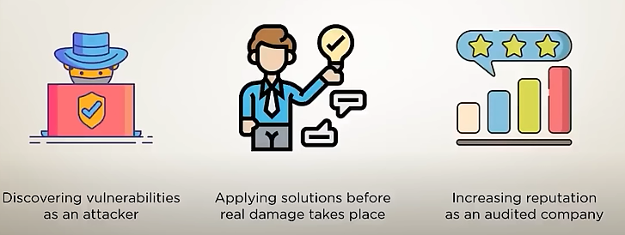
Benefits of Ethical Hacking

Slide 32
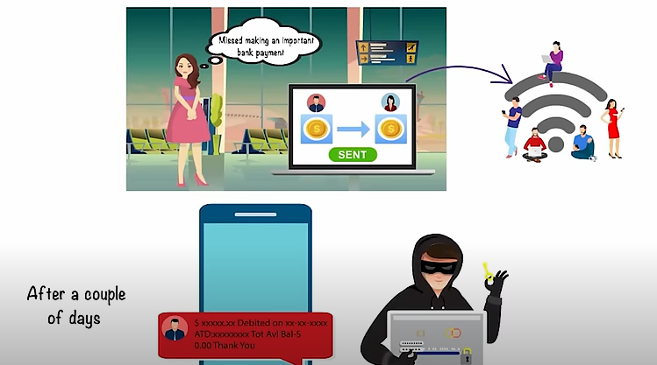

Slide 33
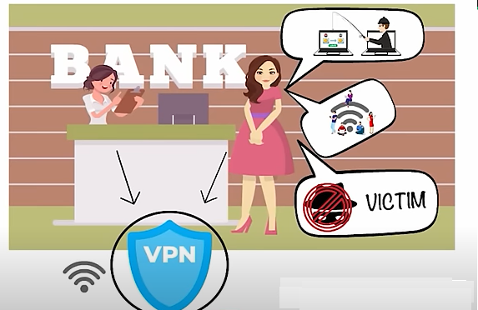

Slide 34
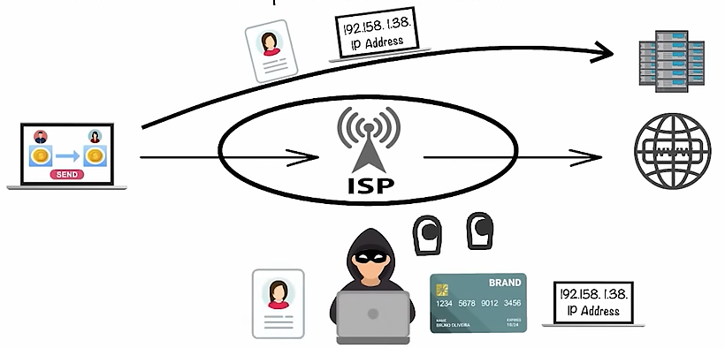
How the hacker would have exploited Jude's transaction in the absence of a VPN

Slide 35
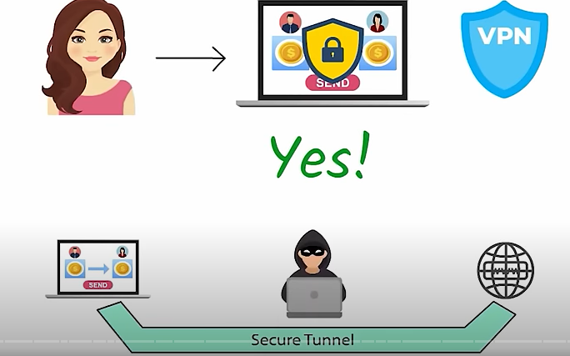

Slide 36
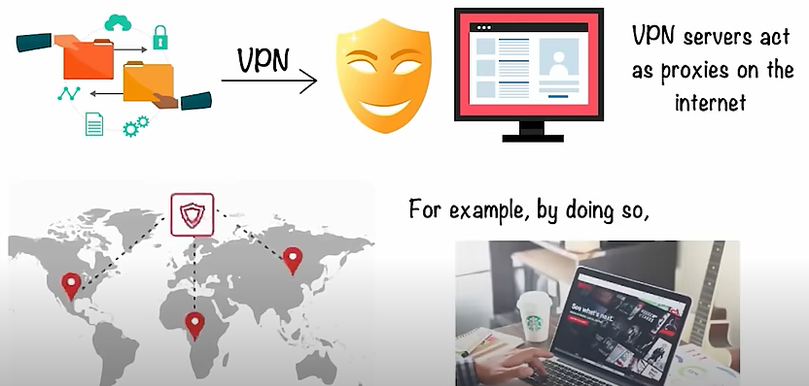

Slide 37
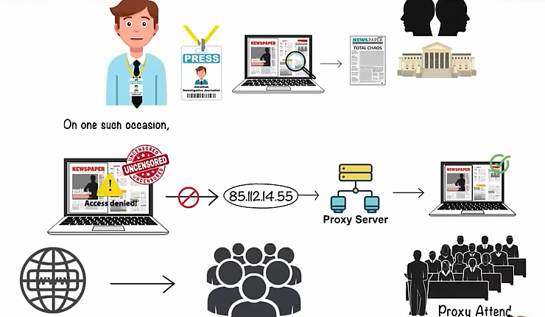

Slide 38
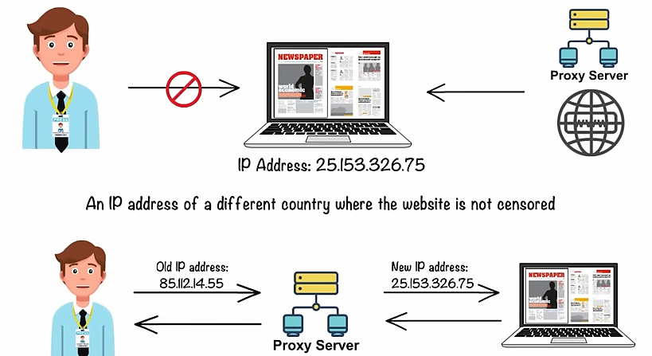
What proxy Server

Slide 39
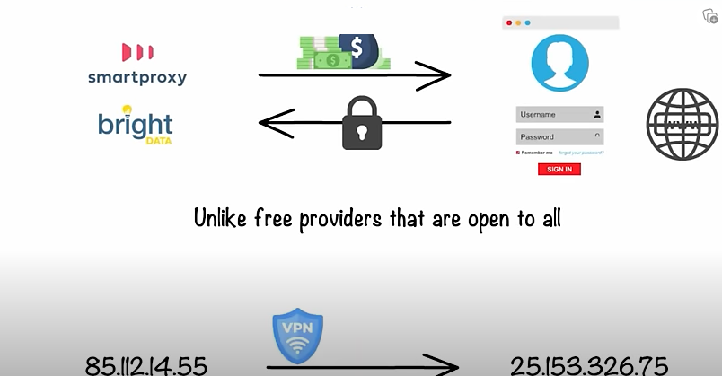

Slide 40
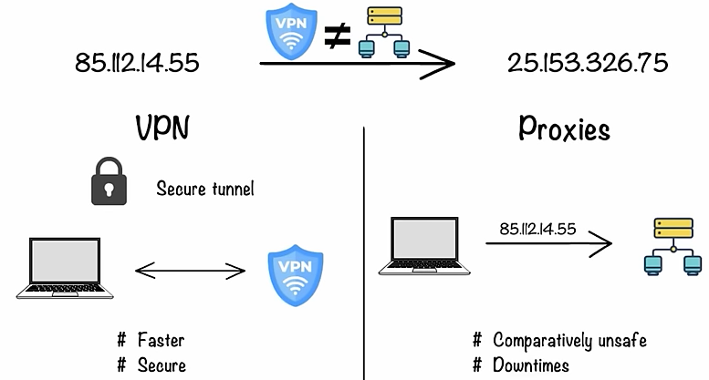
Proxy vs VPN

Slide 41
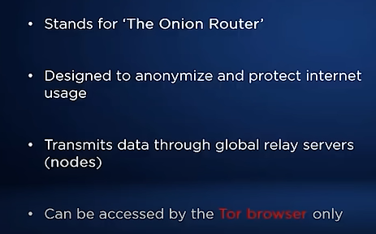
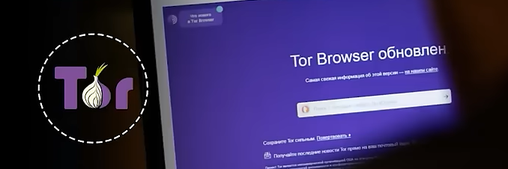
What is Tor Browser
Tor Browser

Slide 42
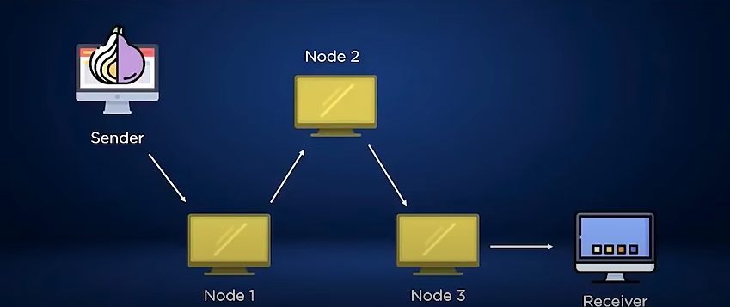
Onion Routing

Slide 43
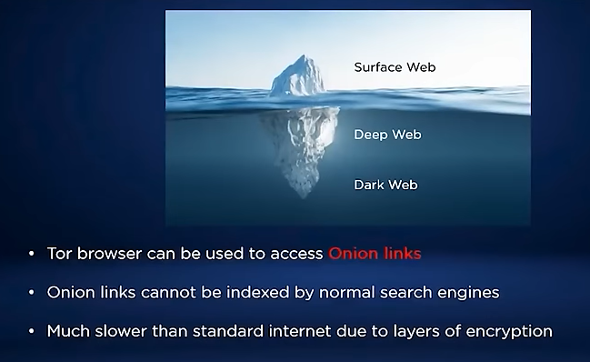
Onion Link and Deep Web

Slide 44
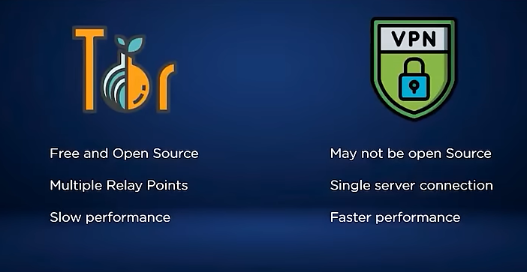
Difference between Tor and VPN

Slide 45
Tor Demo

Slide 46
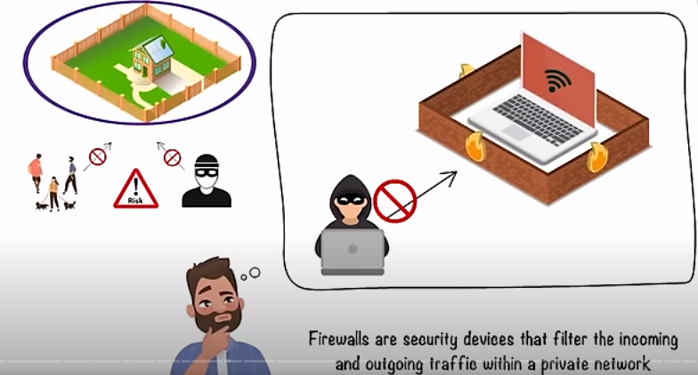
Firewall

Slide 47
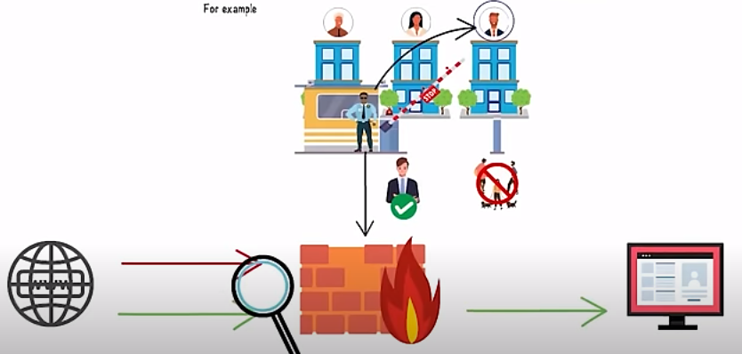

Slide 48
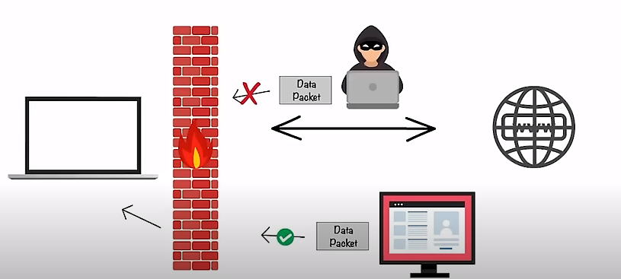

Slide 49
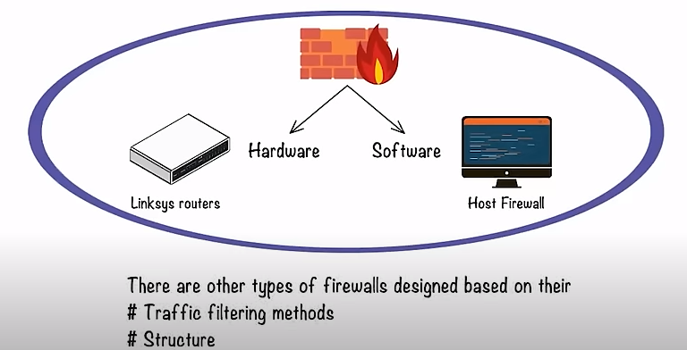

Slide 50
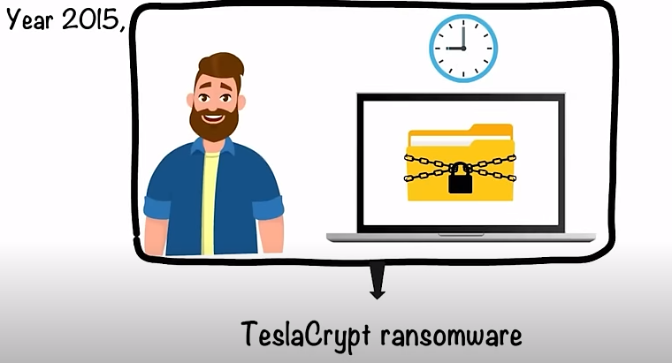

Slide 51
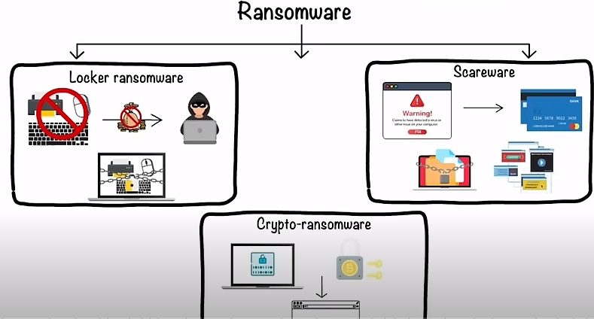

Slide 52
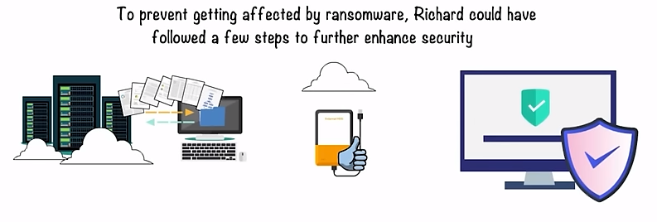

Slide 53
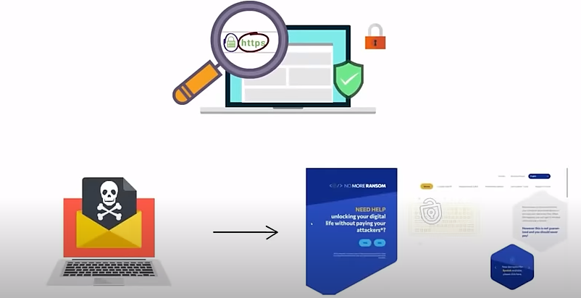

Slide 54
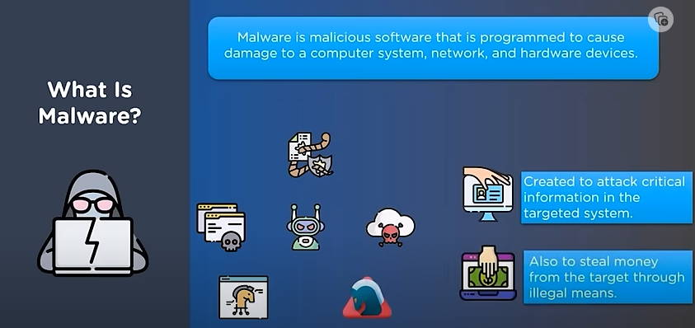

Slide 55


Slide 56


Slide 57


Slide 58


Slide 59


Slide 60


Slide 61


Slide 62


Slide 63

Software for Practice to find vulnerabilities due Sql Injection

Slide 64


Slide 65



Slide 66


Slide 67


Slide 68


Slide 69


Slide 70


Slide 71


Slide 72


Slide 73


Slide 74


Slide 75

Botnet

Slide 76

How Botnet Work

Slide 77


Slide 78

Password Cracking Tool
This password recovery program can recover credentials for Microsoft Windows user account and Microsoft Access password

Slide 79


Slide 80


Slide 81


Slide 82


Slide 83


Slide 84


Slide 86


Slide 87
Commands for kali Linux
nmap [Scan Type(s)] [Options] {target specification}
Scan Types:
TCP SYN Scan (-sS): The default scan that quickly identifies open ports.
TCP Connect Scan (-sT): Establishes a full connection to the target, slower than SYN scan.
UDP Scan (-sU): Scans for open UDP ports.
Aggressive Scan (-A): Enables OS detection, version detection, script scanning, and traceroute.
Ping Scan (-sn): Determines which hosts are online.

Slide 88
Commands for kali Linux
Options:
-p <port ranges>: Specifies port ranges to scan.
-F: Fast mode, scans only the most common ports.
-O: Enables OS detection.
-sV: Version detection, determines service versions running on open ports.
-sP: Ping scan, determines which hosts are online without port scanning.
-v: Verbose mode, provides more detailed output.
-Pn: Treats all hosts as online, skipping host discovery.
-T <timing template>: Adjusts the timing of the scan (e.g., -T4 for aggressive, faster scans).

Slide 89
Commands for kali Linux
Target Specification:
Single Host: An IP address or hostname (e.g., 192.168.1.1 or example.com).
IP Range: Scan a range of IP addresses (e.g., 192.168.1.1-20).
Subnet: Specify a subnet using CIDR notation (e.g., 192.168.1.0/24).

Slide 90
Metasploit Framework:
Command: msfconsole
Description: A powerful penetration testing framework that allows users to develop, test, and execute exploit code.

Slide 91
Wireshark:
Command: wireshark
Description: A network protocol analyzer used for packet analysis and troubleshooting.

Slide 92
John the Ripper:
Command: john [password file]
Description: A password cracking tool that uses dictionary attacks and brute force attacks to crack passwords.

Slide 93
Sqlmap:
Command: sqlmap -u [URL] --dbs
Description: An automated SQL injection tool used for detecting and exploiting SQL injection vulnerabilities in web applications.

Slide 94
Netcat (nc):
Command: nc -zvw [timeout] [host] [port]
Description: A versatile networking tool used for reading and writing data across network connections.

Slide 95


